Slide 1
Pixelmate – Project Management App
Guided by :
Prof. Sampada V. Massey
Presented by :
PRAKHAR SAHU
RACHANA SAHU

Slide 2
INTRODUCTION
Pixelmate is a platform which provide you functionality to store your project details (like technology used in the project, any GitHub repository link, and a description about your project explaining the functions or working) with public API ,which is useful in adding up your project with your portfolio.
An API is a way for two or more computer programs to communicate with each other. It is a type of software interface, offering a service to other pieces of software.

Slide 3
TECHNOLOGY USED

Slide 4

Angular
Angular is an free and open source web application framework.
It is written in Typescript.
It implements core and optional functionality as a set of Typescript libraries that you import into your applications.
It is a Typescript-based JavaScript framework.
Current version is Angular 14.

Slide 5
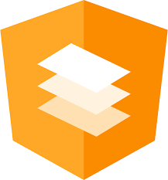
Angular Material
Angular Material is a UI component library for Angular.
It speed up the development of elegant and consistent user interfaces.
It offers you reusable and beautiful UI components like Cards, Inputs, Data Tables, Date pickers, and much more.

Slide 6

Tailwind CSS
Tailwind CSS is an open source CSS framework.
It creates a list of "utility" CSS classes that can be used to style each element by mixing and matching.
Tailwind CSS makes it quicker to write and maintain the code of your application.

Slide 7

MongoDB
MongoDB is a non-relational document database that provides support for JSON-like storage.
It is widely adopted for storing and managing both structured and unstructured data.
MongoDB is designed to make data easy to access.
The maximum BSON document size is 16 megabytes.
MongoDB databases are schemaless.

Slide 8

Django
Django is a high-level, Python-based web framework that follows the model–template–views (MTV) architectural pattern.
It’s free and open source.
The framework emphasizes less code, rapid development, and the principle of don’t repeat yourself.
It is a popular toolkit for building APIs.

Slide 9
Other Python Library
djongo - smarter approach to database querying. It maps python objects to MongoDB documents.
pymongo - Python distribution containing tools for working with MongoDB.
django-cors-headers - Django application for handling the server headers required for CORS.
djangorestframework - powerful and flexible toolkit for building Web APIs.
Pillow - library contains all the basic image processing functionality.

Slide 10
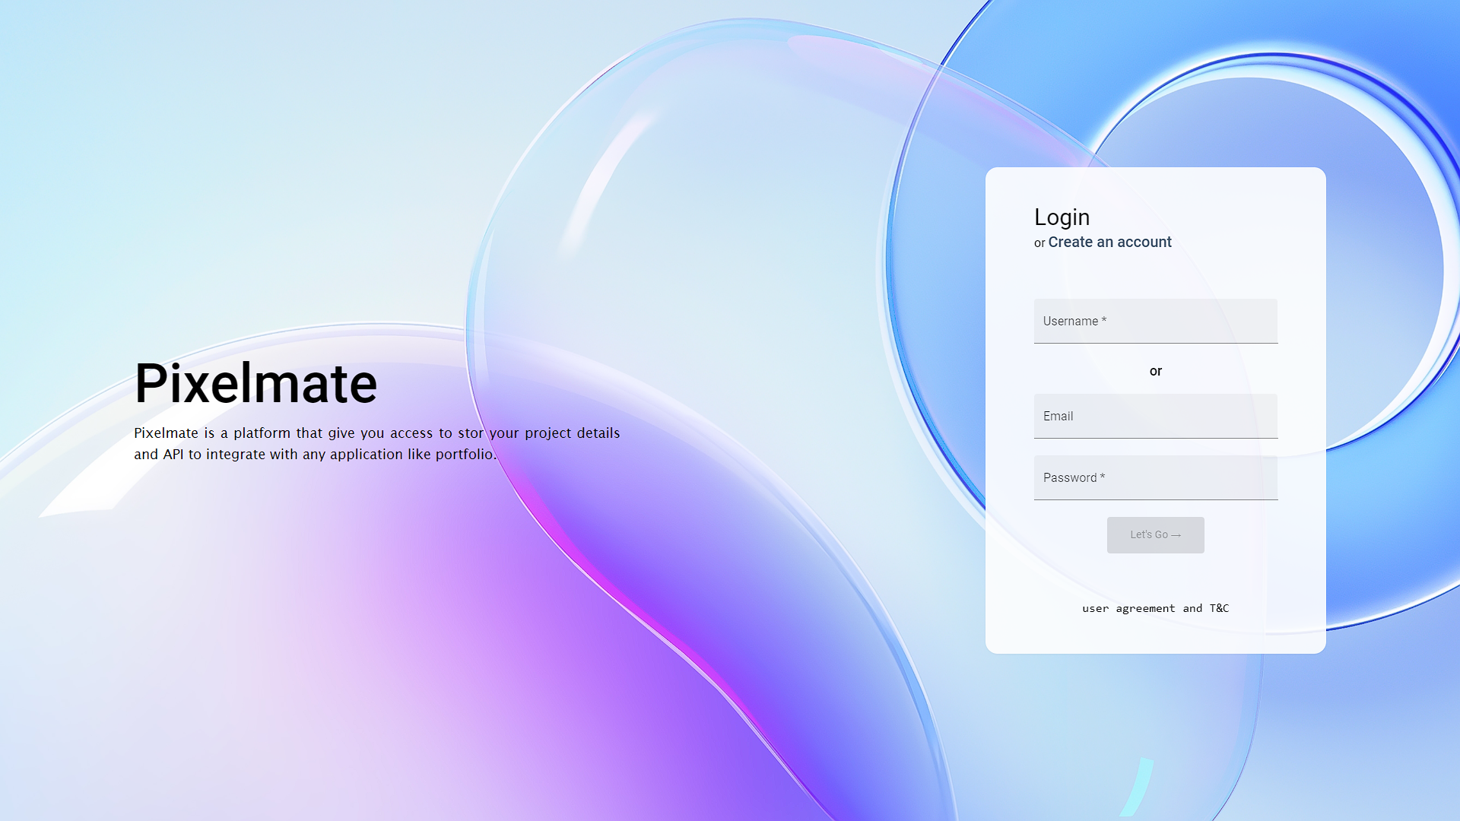
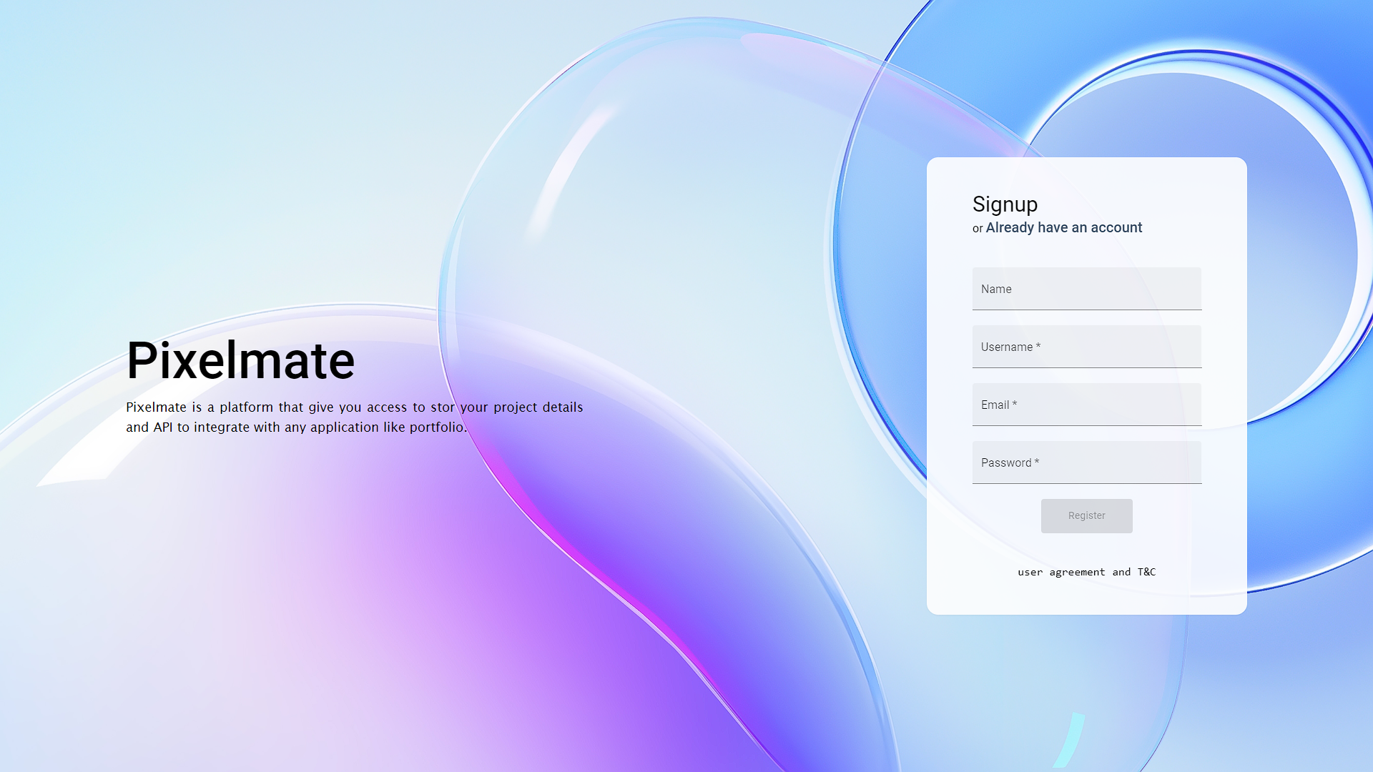
Screenshots

Slide 11
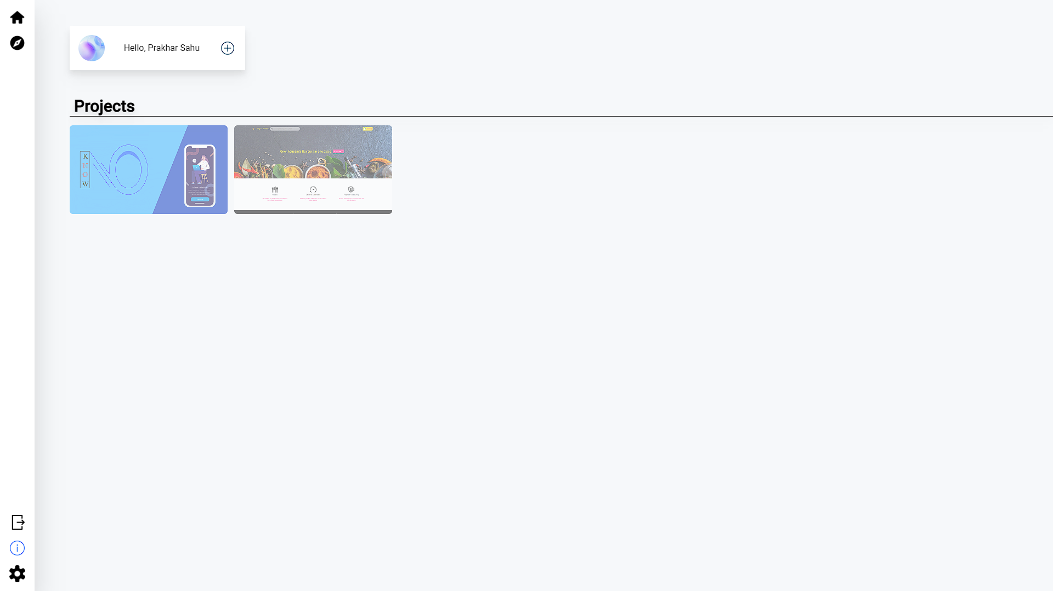
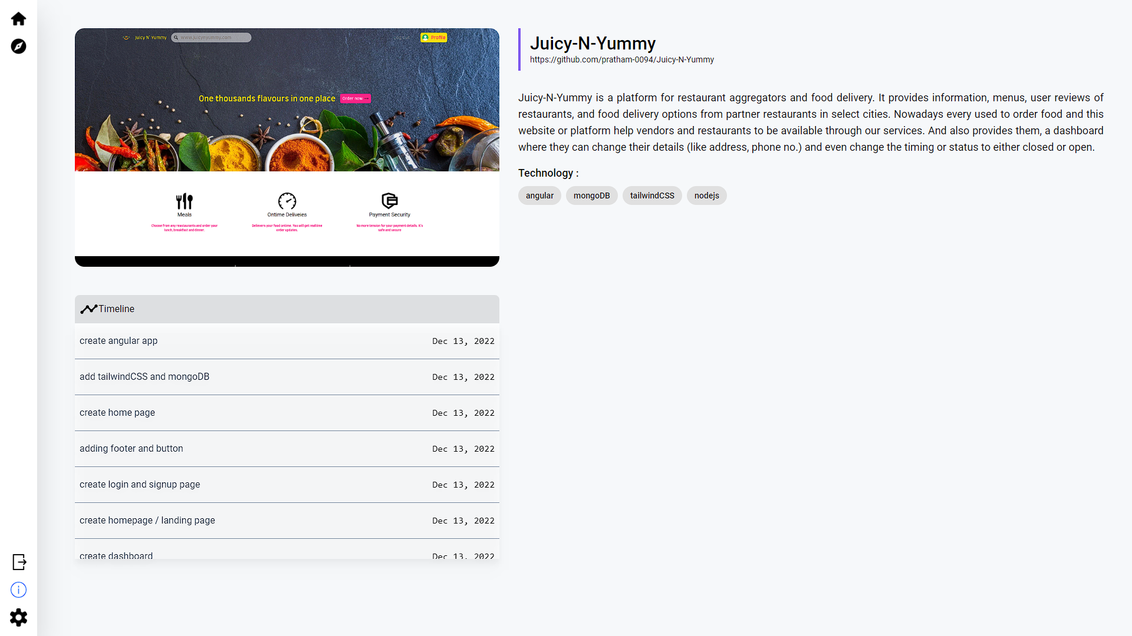

Slide 12
Idea behind this project
Nowadays, if you are a developer than it is must that you have to make some projects to show the level of experience and skills you have. And portfolio website is the best way you can talk about yourself i.e. skills, project, social media handles, industry experience or internships. So, more projects has more impact and helpful to build your resume.
As the portfolio is hosted so every time you make project you have to change the files and again host the portfolio. So, to solve this problem, we made this platform where you can store the data (project details) and show your projects in your portfolio website using the API’s (as the data will be store and retrieve from database) You don’t have to worry about changing the files from the hosted server.

Slide 13
Reference from Official Documentation
https://angular.io/
https://material.angular.io/
https://tailwindcss.com/
https://www.djangoproject.com/
https://www.djongomapper.com/
https://www.youtube.com/watch?v=I17uA1sVQ2g

Slide 14
THANK YOU

